Slide 1
Intro
The purpose of this project is to validate the data in the Coffee Shop Sales Dashboard (PowerBI)
by querying MySQL database directly. This is to ensure measures and calculations in Power BI are
correctly implemented. The Coffee Shop Sales Dashboard is also included on the Power BI section of this
portfolio.

Slide 2
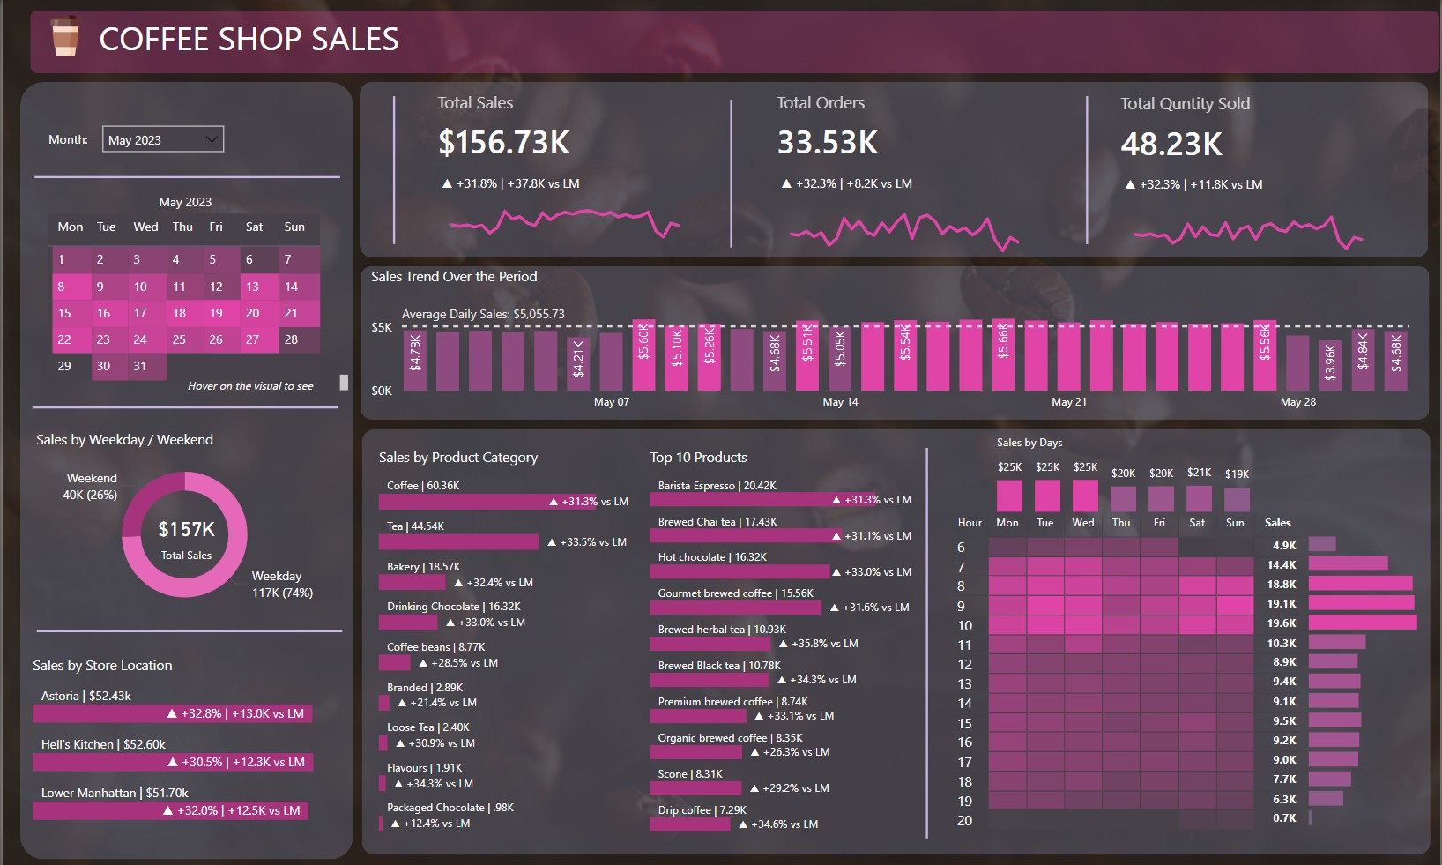

Slide 3
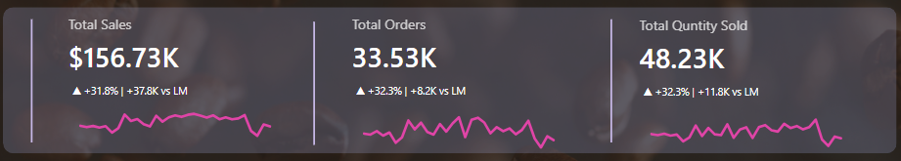
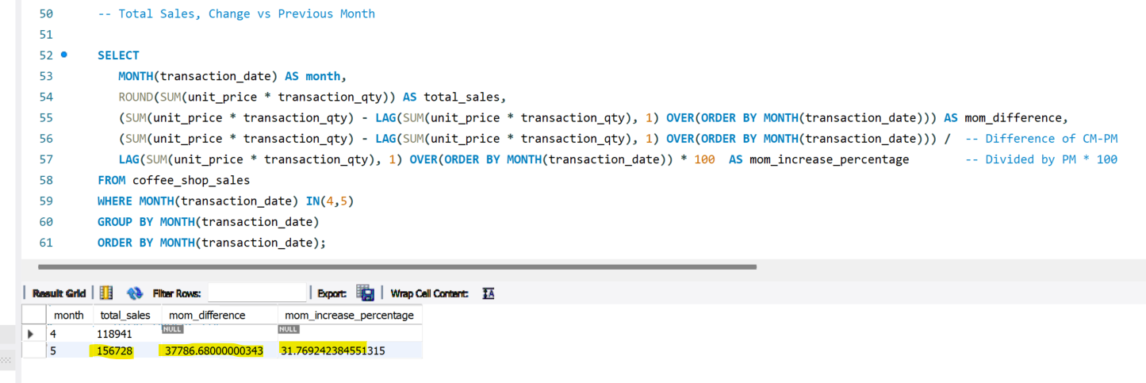
Total Sales, % Change vs Previous Month

Slide 4
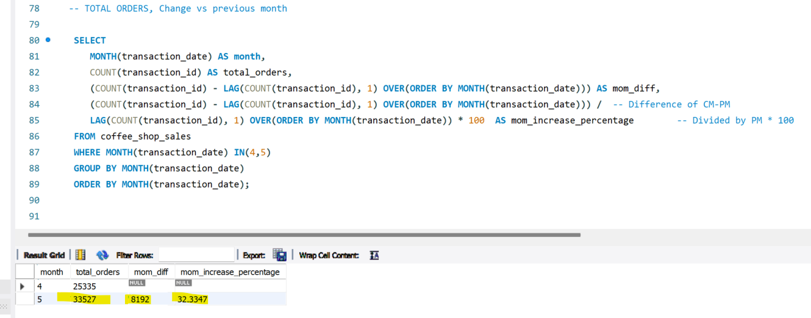
Total Orders, % Change vs Previous Month

Slide 5
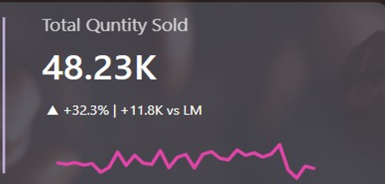
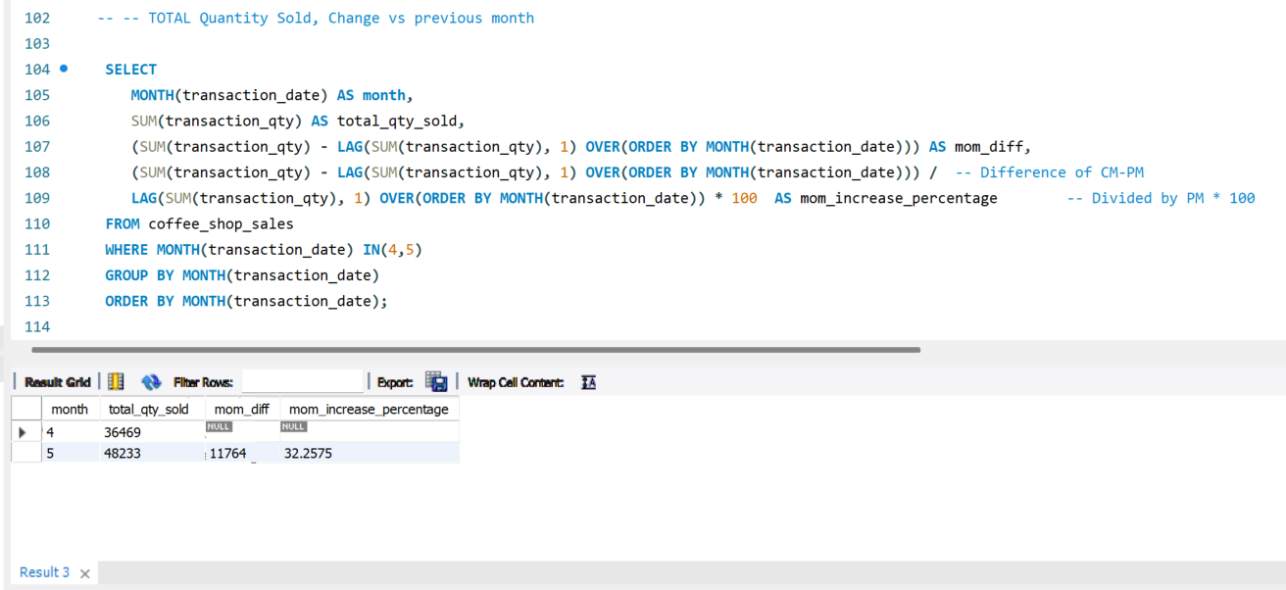
Total Quantity Sold, % Change vs Previous Month

Slide 6
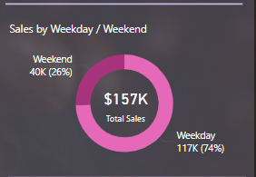
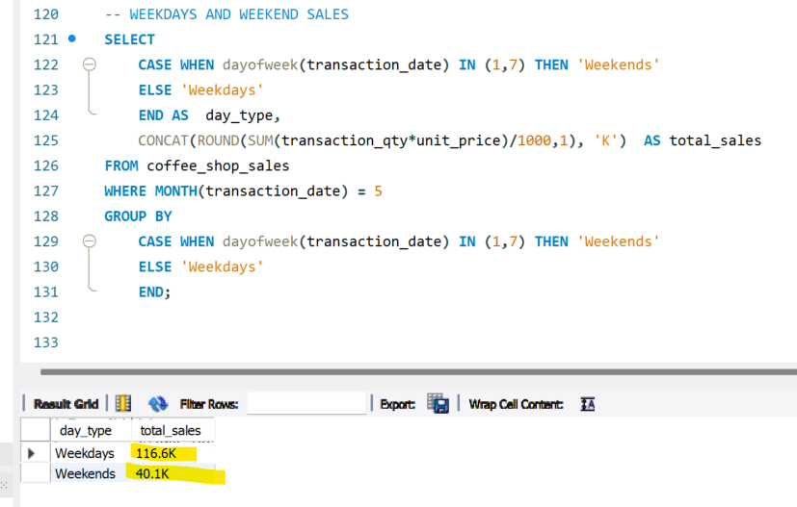
Sales by Weekdays vs Weekend

Slide 7
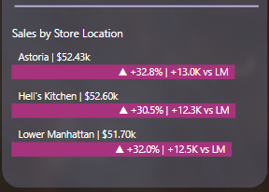
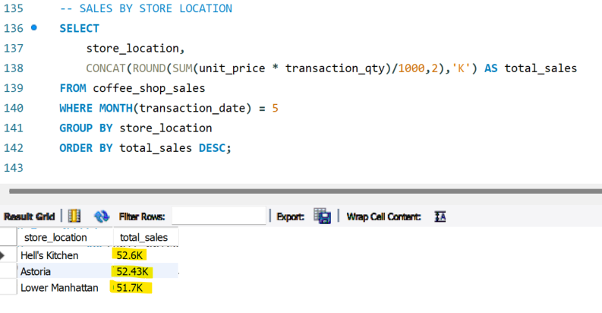
Sales by Store Location

Slide 8
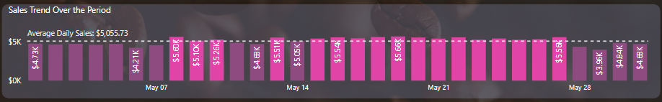
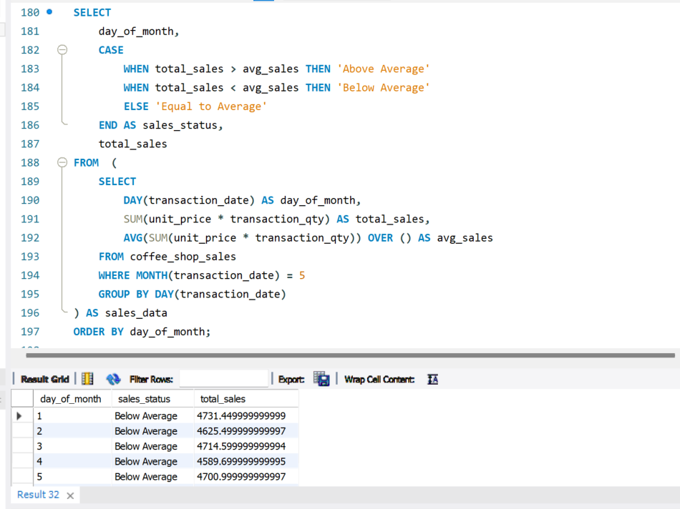
Daily Sales vs Avg Daily Sales (Above or Below AVG)

Slide 9
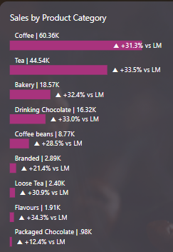
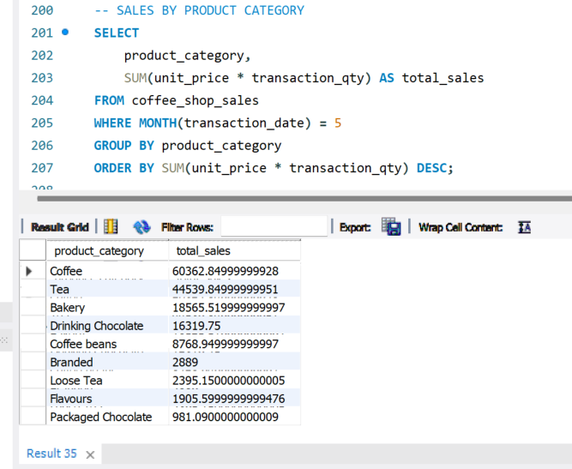
Sales by Product Category

Slide 10
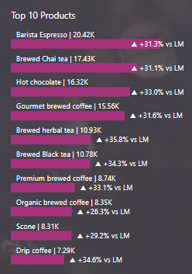
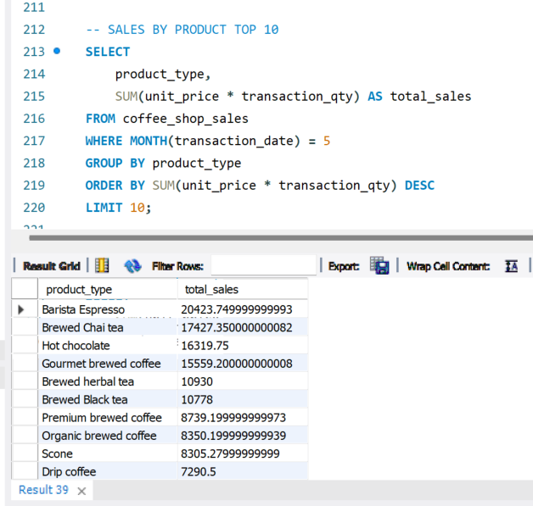
Top 10 Products

Slide 11
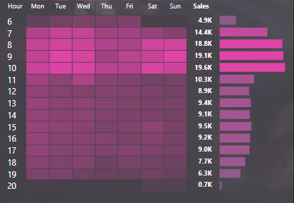
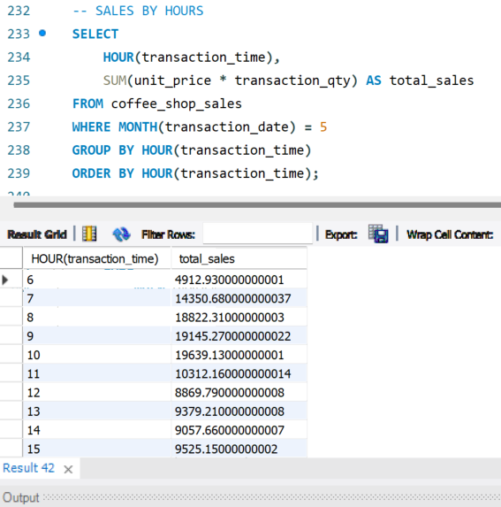
Total Hourly Sales

Slide 12
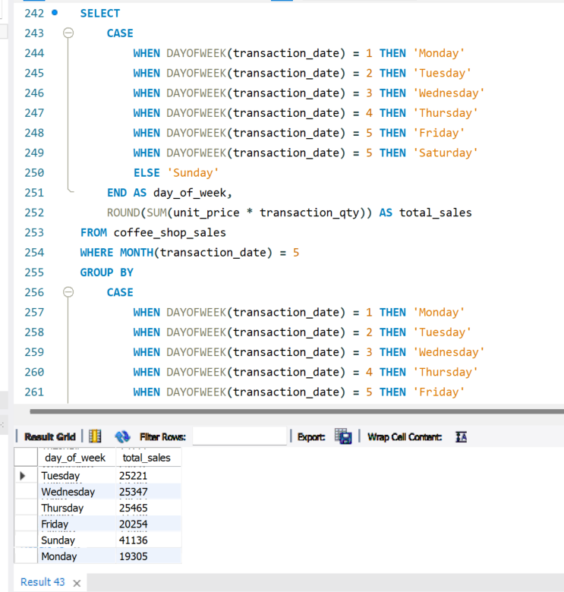

Sales By Days

